Slide 1
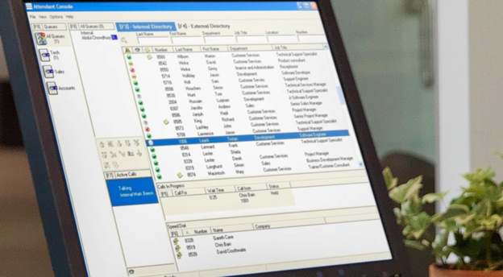


Cisco Unified
Attendant Consoles
CUEAC E.164/BLF/DN Mapping Explanation

Slide 2
Definitions
Term | Definition
DN | Extension of endpoint device (number dialed to ring endpoint)
Extension Field | Field in CUxAC directory
E.164 / +E.164 | International public telecommunication numbering plan.

Slide 3
Law of CUxAC Busy Lamp Field
CUxAC Directory Field:
Extension
DN
If value in Extension field exactly matches DN, then BLF works
CUxAC Directory Field:
Extension
DN
If value in Extension field DOES NOT exactly match DN, then BLF DOES NOT work

Slide 4
Common Mapping Problem
LDAP Directory Field:
Phone # = E.164 format
CUCM Directory
Field:
telephonenumber
CUxAC Directory Field:
Extension
CUxAC Directory Field:
Extension
DN
If value in Extension field DOES NOT exactly match DN, then BLF DOES NOT work

Slide 5
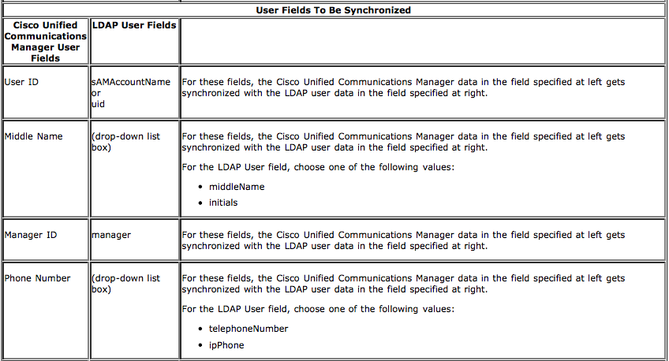
CUCM/LDAP Mapping Limitation

Slide 6
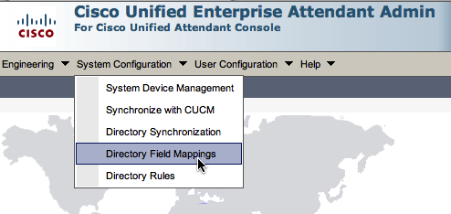
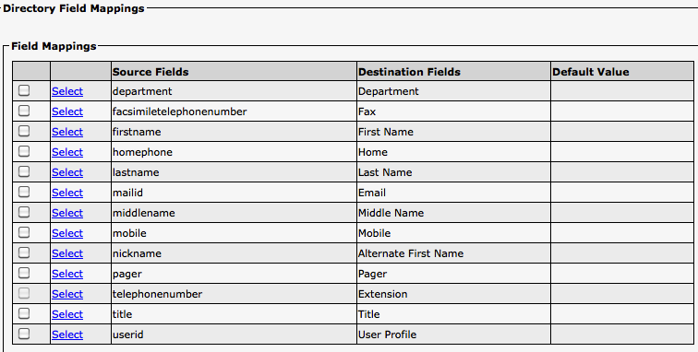
CUEAC Directory Field Mapping
NOTE: Directory Field Mappings is not available in CUBAC or CUDAC

Slide 7
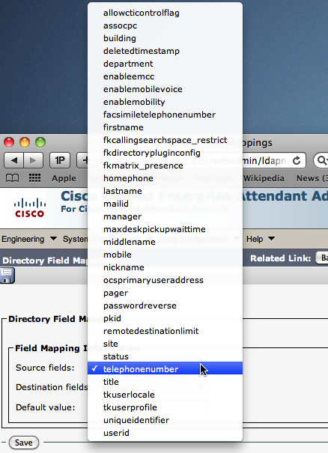
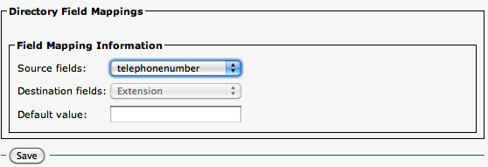
If E.164 field from LDAP is mapped to telephonenumber field in CUCM directory…
use a different CUCM field to store DN, and map that field to CUEAC Extension field
CUCM Source Fields that can map to CUEAC directory

